Slide 1
NEWS
TECH
CLOUD
SEARCH
copyright © 2016

Slide 2
NEWS
TECH
CLOUD
SEARCH
pastry
homemade cakes
fruit
coconut
bread
custard croissant
breakfast
healthy breakfast
fruit
strawberries
recommend
breakfast
lunch
healthy
creative
funny
child
america
others
copyright © 2016

Slide 3

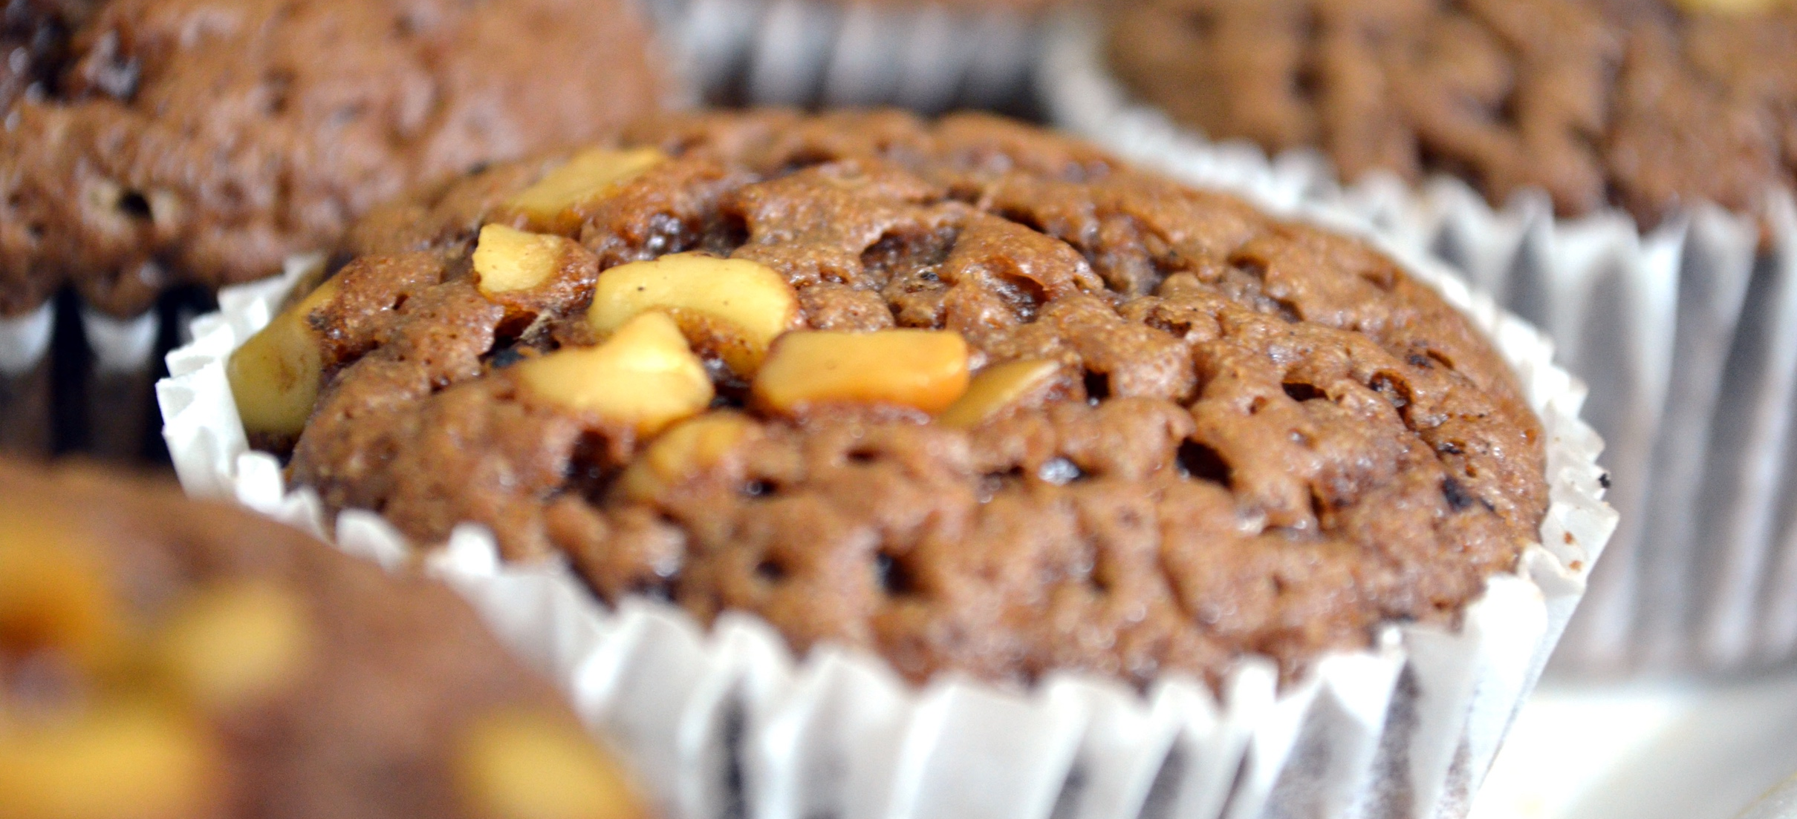
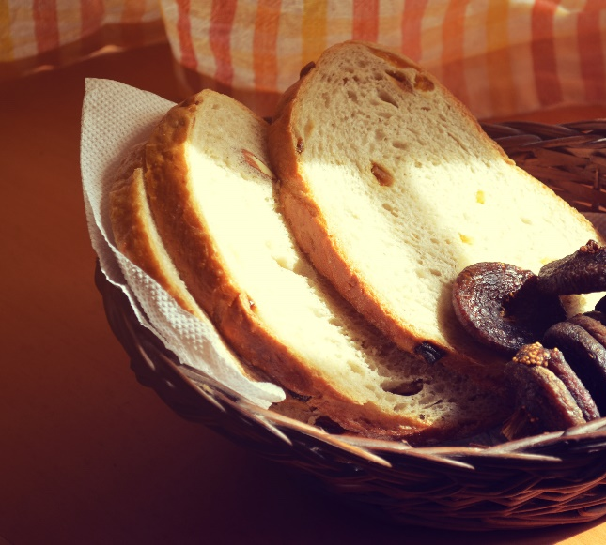
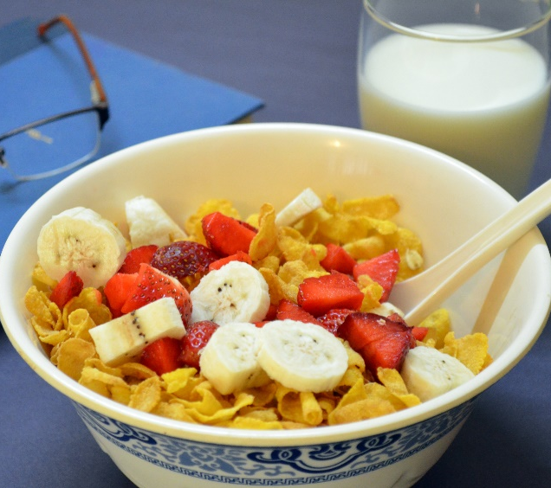


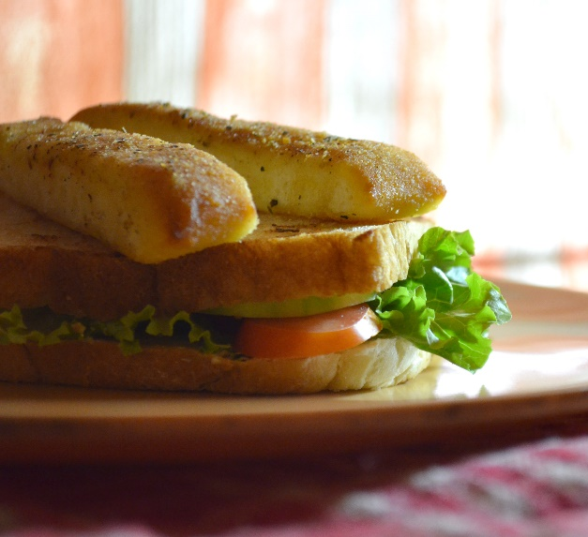
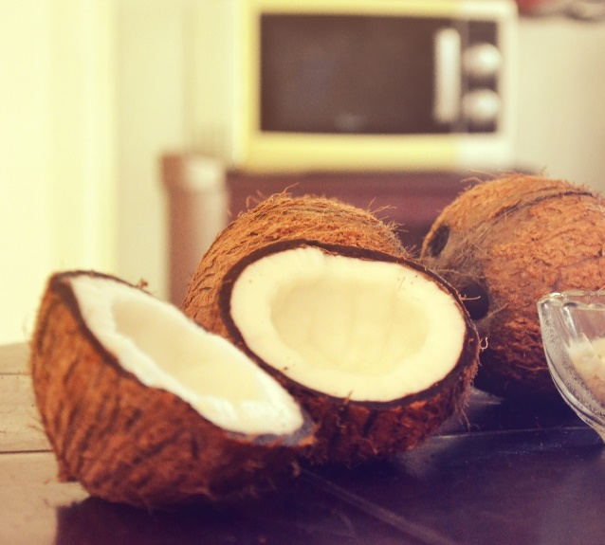



NEWS
TECH
CLOUD
SEARCH
pastry
homemade cakes
fruit
coconut
bread
custard croissant
breakfast
healthy breakfast
fruit
strawberries
recommend
breakfast
lunch
healthy
creative
funny
child
america
others
copyright © 2016

